Slide 1

Capstone Project- Regression
NYC Taxi Trip Time Prediction
By
Manmohan Madhu

Slide 2
Predicting the trip duration of a taxi ride
Import data and libraries
EDA
Feature engineering
Machine learning
Evaluation the results
Conclusion

Slide 3
Dataset
Independent variables
id | pickup_latitude
vendor_id | dropoff_longitude
pickup_datetime | dropoff_latitude
dropoff_datetime | store_and_fwd_flag
passenger_count | trip_duration
pickup_longitude
Dependent variables
trip_duration

Slide 4
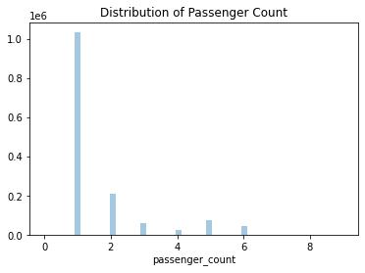
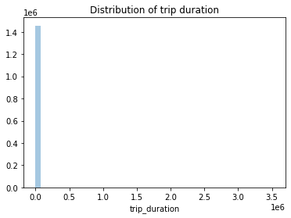
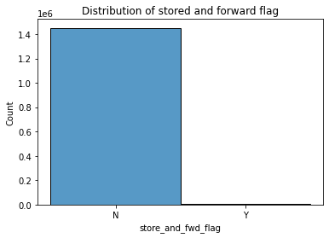
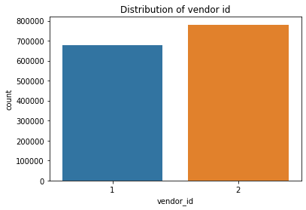
Exploratory Data Analysis
Univariate analysis

Slide 5
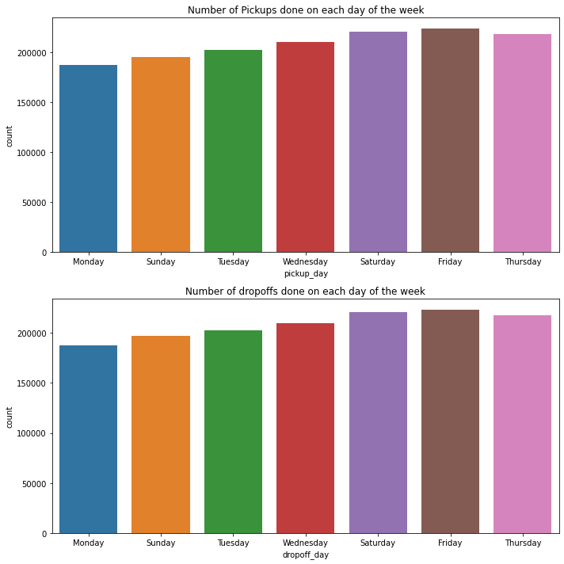
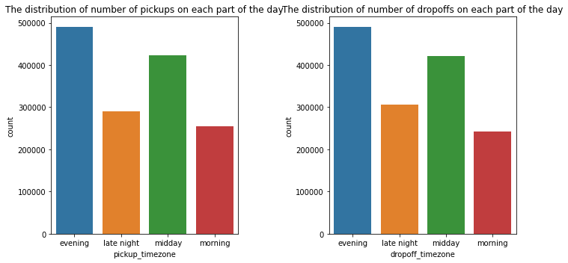
Exploratory Data Analysis
Univariate analysis

Slide 6
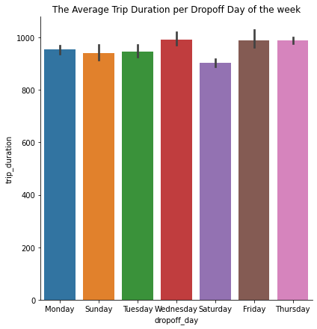
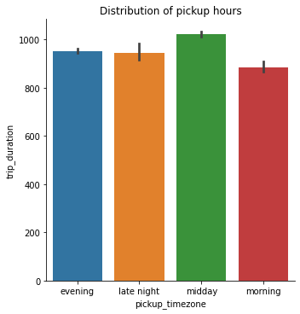
Exploratory Data Analysis
Bivariate analysis

Slide 7
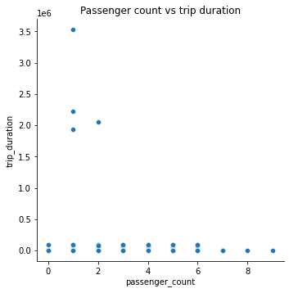
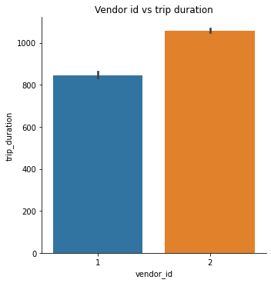
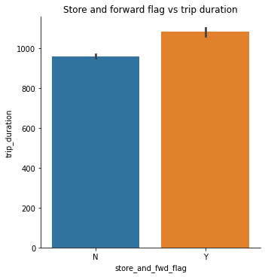
Exploratory Data Analysis
Bivariate analysis

Slide 8
Findings from EDA
1. Passenger count and store forward flag does not show any trend with respect to trip duration.
2. Trip duration has extreme outliers.
3. Most number of trips are taken on Fridays and the least on Mondays.
4. Higher number of trips are taken on evenings and midday.
5. Vendor 2 provides more trips than vendor 1.

Slide 9
Feature Engineering
Calculating distance between coordinates using the Haversine formula.
Extracting month from datetime column.
One hot encoding of categorical variables.
Handling of outliers in trip duration and distance.

Slide 10
Machine Learning using Linear Regression, XGB Regression and Ridge Regression
Model | RMSE of test data
Linear Regression | 275.83
XGB Regressor | 262.45
Ridge Regression | 275.83

Slide 11
Conclusion
The lowest RMSE obtained using the above mentioned three models is 260 seconds which is negligible compared to our range of nearly 2000 seconds. Therefore, we can confidently use this model for predictions.

